Slide 1
MachinE LEarning
Computational Models In Cognitive Science:
Classification Models In Machine Learning

Slide 2
Today’s Outline
Brief Introduction to:
Data Science
Machine Learning
Computational Science
Classification Models

Slide 3
Computational Science
Science Discipline: Psychology, Neuroscience, Biology, Economics, Political Science, Education, Business, etc.
Applied Mathematics & Numerical Models:
Probability & Statistics, Calculus, Linear Algebra, Graph Theory, Information Theory, Topology, Dynamical Systems Theory, etc.
Computer Science:
Programming, Algorithms and Data Structures

Slide 4
Steps in the Data Science Process
Defining the Question
Getting Data
Preparing Data
Exploring Data
Modeling Data
Communicating About Data

Slide 5
Machine Learning vs. Statistics
Y = mx – b
Y = b₀ + b_{1 *} x₁ + E

Slide 6
Machine Learning vs. Statistics
Generalized Linear Model
 | Quantitative Predictor(s) | Qualitative Predictor(s)
Quantitative Outcome(s) | Regression | ANOVA
Qualitative Outcome(s) | Logistic Regression | Chi-Square

Slide 7
Continuum of Complexity
Statistics → Machine Learning → Computational Models
Statistics are about using data to make inferences and predictions
Machine learning is what we tend call it when the learning or data representation gets more complex, like:
a deep neural network rather than simple logistic regression
using many predictors to predict many outcomes.
Computational modeling or computational science is what we tend to call it when we are moving beyond descriptive explanations, and trying to model or simulate the process

Slide 8
Model Space
D
Complexity (Parsimony)
Correctness
Their Ratio
A
B
C

Slide 9
Instrumentalism Vs. Realism
What is the point of a model? Or really, of science in general?
Prediction?
Explanation?
Accurate depiction of reality?
Thirst example
This Model has 6 Parameters
Salt Level
Water Level
Body Temperature
Water Seeking Behavior
Dry Mouth
Dry Skin
Thirst
Model Quality = Prediction Error / # of Parameters

Slide 10
What is Machine Learning?
Three Different Branches of machine learning
Supervised Learning
Unsupervised Learning
Reinforcement Learning

Slide 11
Supervised Learning
Correlation and Regression

Slide 12
Supervised Learning
Classification

Slide 13
Unsupervised Learning

Slide 14
Reinforcement Learning
Neuroscience
Cognitive Psychology
Social and Group Behavior

Slide 15
Supervised Learning

Slide 16
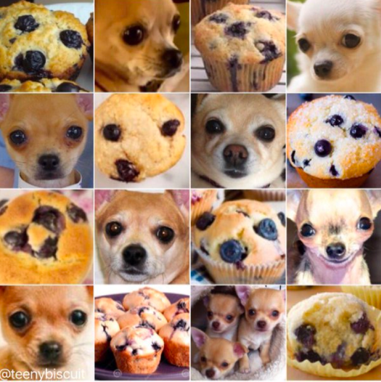
Many Classification Problems Arent Easy

Slide 17
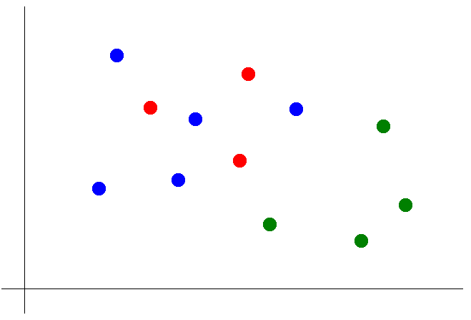
K Nearest Neighbors
Suppose we want to predict the color of the gray dot.
1) Pick a value for k.
2) Find colors of k nearest neighbors.
3) Assign the most common color
to the gray dot.

Slide 18
K Nearest Neighbors
Advantages of KNN:
Simple to understand and explain
Model training phase is fast
Non-parametric (does not presume a “form” of the “decision boundary”)
Disadvantages of KNN:
Prediction phase can be slow when n is large
Parametric methods will be better than KNN if the selected form is close to the “true” form
Parametric methods tend to be better than KNN for small n and large p (in other words, KNN overfits)
Does not provide coefficients or p-values
Sensitive to irrelevant features
Sensitive to unscaled data

Slide 19
Logistic Regression for Discrete Outcomes
We want to classify an outcome variable y is either belonging to or not belonging to a particular category.

Slide 20
Logistic Regression for Discrete Outcomes
We want to classify an outcome variable y is either belonging to or not belonging to a particular category.

Slide 21
Multiple Logistic Regression for Discrete Outcomes
y = 1
1 + e^{-z} where z = b₀*1 + b₁*x₁ + … + b_{n}*x_{n} + E

Slide 22
Ethical Data and Computational Science
The point of science is to discover the truth, not to show that your pre-existing beliefs were right. So stay open minded.
Be aware of other possible explanations of your data.
Be aware if theories other than the one you support.
Always ask yourself: “What would person X, who disagrees with my theory, say about this data, model, or explanation?”

Slide 23
Ethical Data and Computational Science
With Great Power Comes Great Responsibility!
You have many opportunities to manipulate your data and models to produce whatever outcome you want.
Don’t do it, because its wrong. And because you will get caught.
You can help contribute to an atmosphere that encourages ethical data science.
Write readable, commented code.
Publish your code.
Publish your data.
Document all the steps and choices you make

